Slide 1
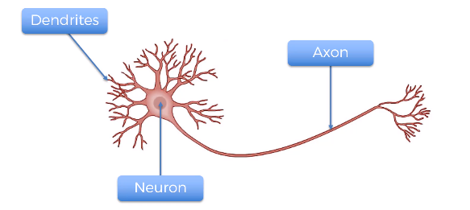
What is Neuron
X1
X2
w1
w2
X3
w3
X4
neuron
w4
OUTPUT
w5
X5
X6
.
.
.
.
X8

Slide 2


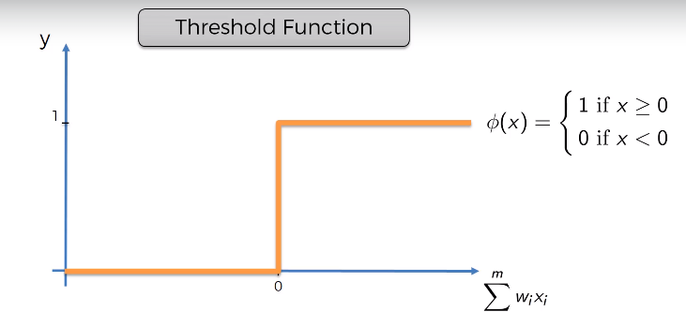
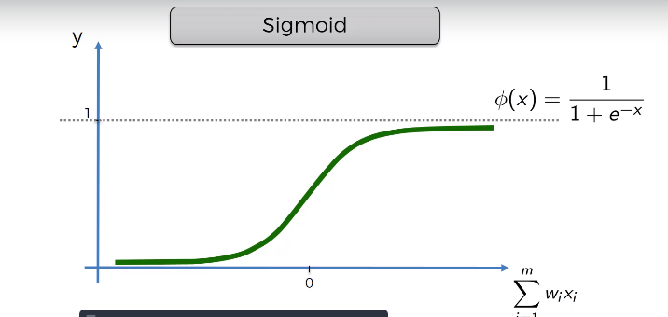
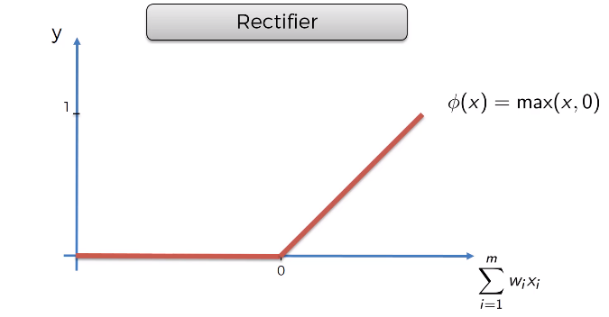
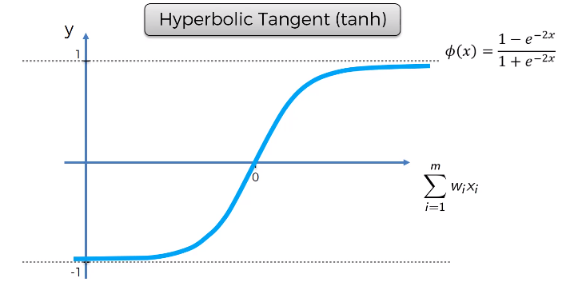
Activation functions
neuron
neuron

Slide 3
How does this work for our use case
The Weights get multiplied with their respective feature values .
Sum( w(i) * x(i))
Now this goes into a function of sigmoid
1/(1+e^-(sum(w(i)*x(i)))
Is it similar to the equation we solved yesterday !
This is the same logistic regression , then what is the point of
This new approach.
How is the functional method different , and how does it work !
Do you guys know what is parametric form and nonparametric form!
X1
X2
w1
w2
X3
w3
X4
SIGMOID
w4
OUTPUT
w5
X5
X6
.
.
.
.
X8

Slide 4
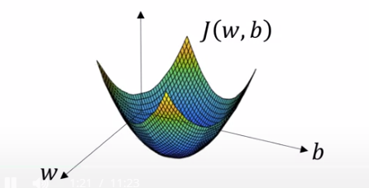
How does this work for our use case-2
The difference is the backpropagation. There is a methodology where we update/Rectify the weights for an optimal result.
W1 gets updated by w1-(alpha*d(dw)) [ Because any additional delta in W adds to the Delta in o/p]
Alpha is the learning rate and dw(derivative) is the slope calculated for a weight.B is the error associated with each weight , which eventually culminates to b(0)

Slide 5
How does this work for our use case-3
Let me explain the concept in paint.
How does learning rate work .
There is a name for this method.
(Gradient descent)

Slide 6
How are we solving for our logistic regression example

Slide 7
So what's next
We will have a detailed derivation of how mathematically this works for a neuron! How do we initialize weights, does It matter if the initialization changes
Can there be a case of over-fitting?
We will then see a shallow network , understand it .
Then we will see how it works for a dense network.
Then the concept of neural network will be complete.

